Slide 1
Healthcare Data Analysis: Uncovering Insights from Patient Records Submitted by: Gurpreet Singh (ID: 0283945) Bhavinkumar J Patel (ID:0285763) Md Sahid Parvez (ID:0276904) Randeep Kaur (ID: 0283916) Presented by: Group Winter Course: Data Visualization Submitted to: Dr. Shervin Espahbod

Slide 2
01
Introduction
02
Data Description
03
Data Analysis Storytelling
04
Dashboard Overview
CONTENTS
05
Conclusion and References

Slide 3
Introduction
Like many industries, healthcare is in a state of continuous improvement. We are looking for better ways of treating patients and achieving better outcomes.
The presentation focuses to analyse data of healthcare, which includes patient details as well as medical features and condition. This analysis also helps to understand treatment patterns, medication regimes, and outcomes by using data visualization
The importance of analysing health data helps as a tool to enhance patient care and it also helps to optimise the resource allocation along with informed decision making with in healthcare management. It analyses the data set containing patient details, medical features , treatment and billing amounts, healthcare management can identify patterns and areas for their improvement.
It helps to make more effective healthcare decisions and improve the professionals for better results to meet required needs of different patients. So, these datasets improve health outcomes and increase the process and quality of patient care.

Slide 4
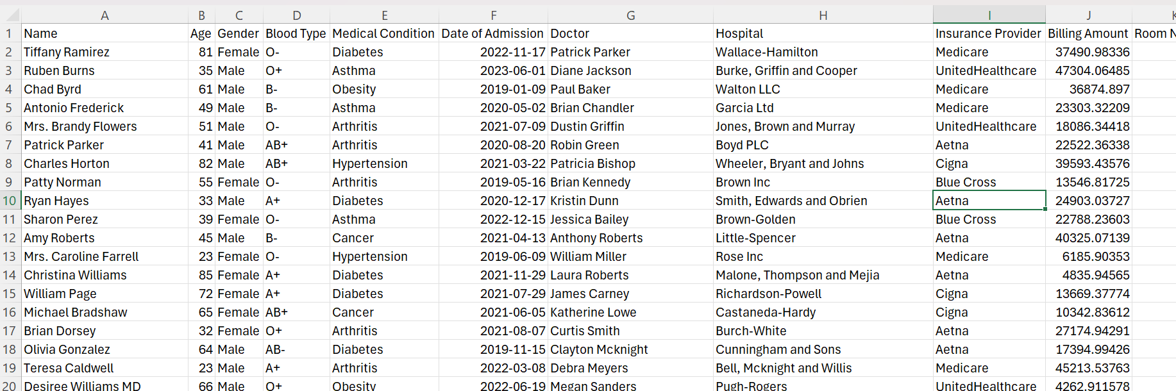
Data Description
The dataset contains extensive patient records, covering demographic information such as Name, Age, and Gender, along with medical details like Blood Type and Medical Condition. It also includes treatment specifics such as Doctor and Medication, as well as healthcare facility data like Hospital and Room Number. Key admission and discharge information such as Date of Admission, Admission Type, and Discharge Date are also included.
The data contains 10000 rows and 15 columns There is no null and duplicate values in the data. We created two columns namely, ‘Age Group’ and ‘Days in Hospital’.

Slide 5
Data Analysis Storytelling
Patient Demographics
Medical Conditions
Hospitals and Doctors Trend
Healthcare Utilization
Insurance Coverage

Slide 6
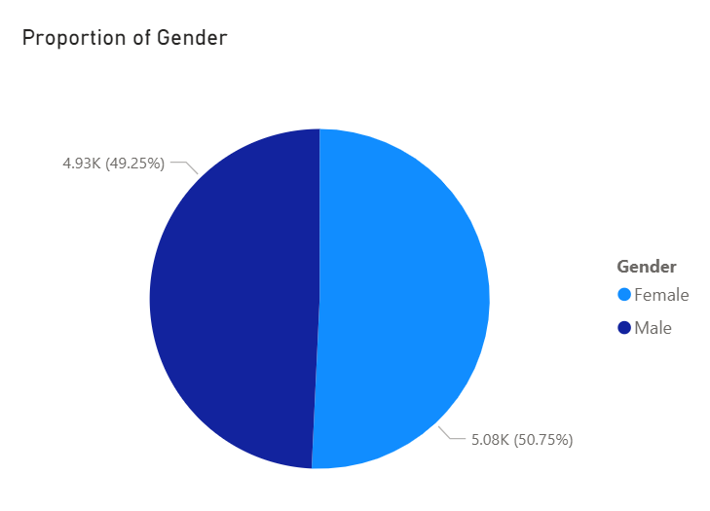
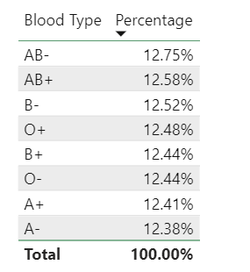
1. Patient Demographics
Pie Chart showing the Distribution of Patients by Gender and a Table showing the percentage of patients with each blood type.
Interpretation: The female gender dominates in the dataset and AB- is the leading blood group in the dataset, followed by AB+.

Slide 7
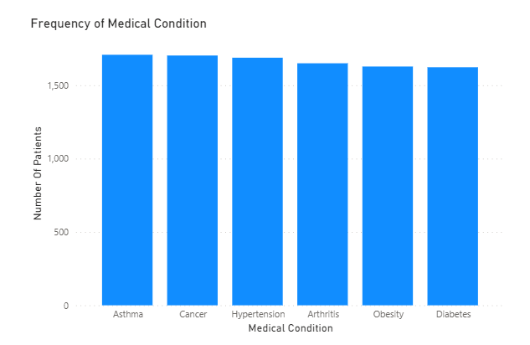
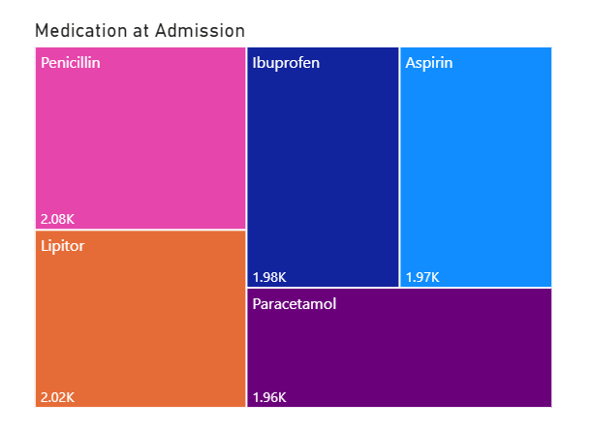
2. Medical Conditions
Bar graph to illustrate the prevalence of different medical conditions among the patients and a Treemap to show the frequency of each Medication at Admission
Interpretation: Asthma and Cancer are the top two primary medical condition and Penicillin is the most prescribed drugs at Admission followed by Lipitor.

Slide 8
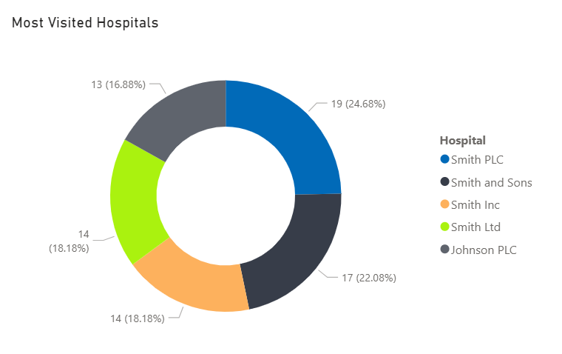
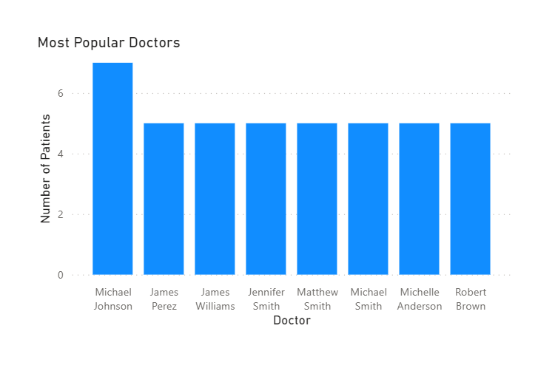
3. Hospitals and Doctors Trend
Donut Chart to illustrate most visited Hospitals and a Bar Graph to show top visited Doctors.
Interpretation: Smith PLC is the most visited hospital and Micheal Johnson is the most popular doctor.

Slide 9
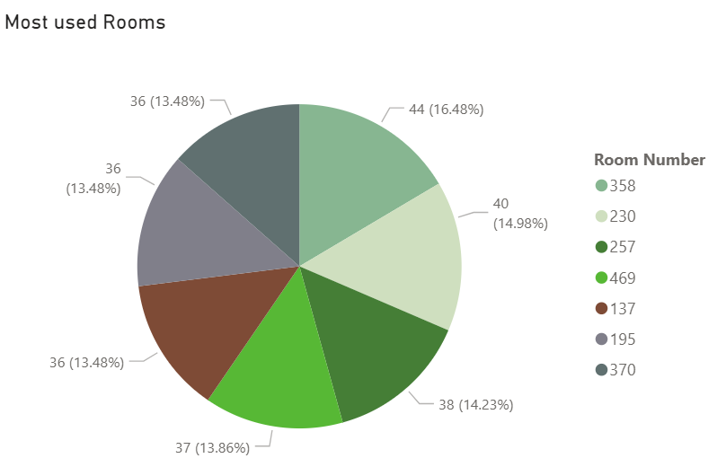
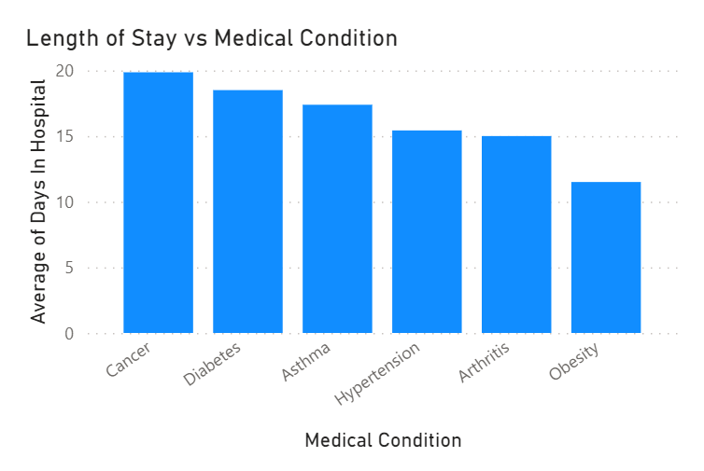
4. Healthcare Utilization
Pie Chart to illustrate most used rooms and a Bar Graph to show average length of hospital stay for patients with different medical conditions.
Interpretation: The most used room is Room Number 358 and Patient with Cancer stays longer than other.

Slide 10
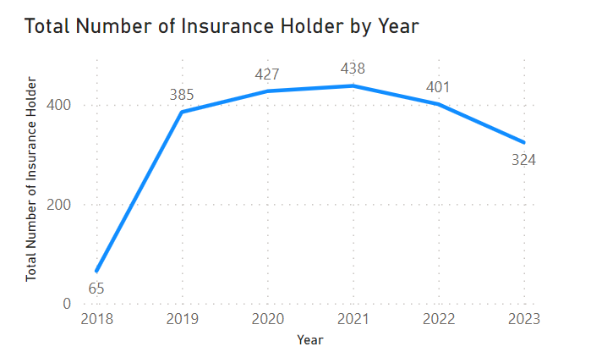
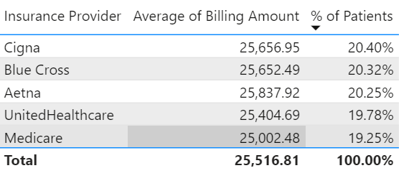
5. Insurance Coverage
Line Graph to demonstrate trend of Insurance Provider over the years and a Table to show the percentage of patients covered by each insurance provider and the average billing amount for each.
Interpretation: There is sudden increase in number of Insurance holder at the start of 2019 and Cigna pays highest amount of bill on average.

Slide 11
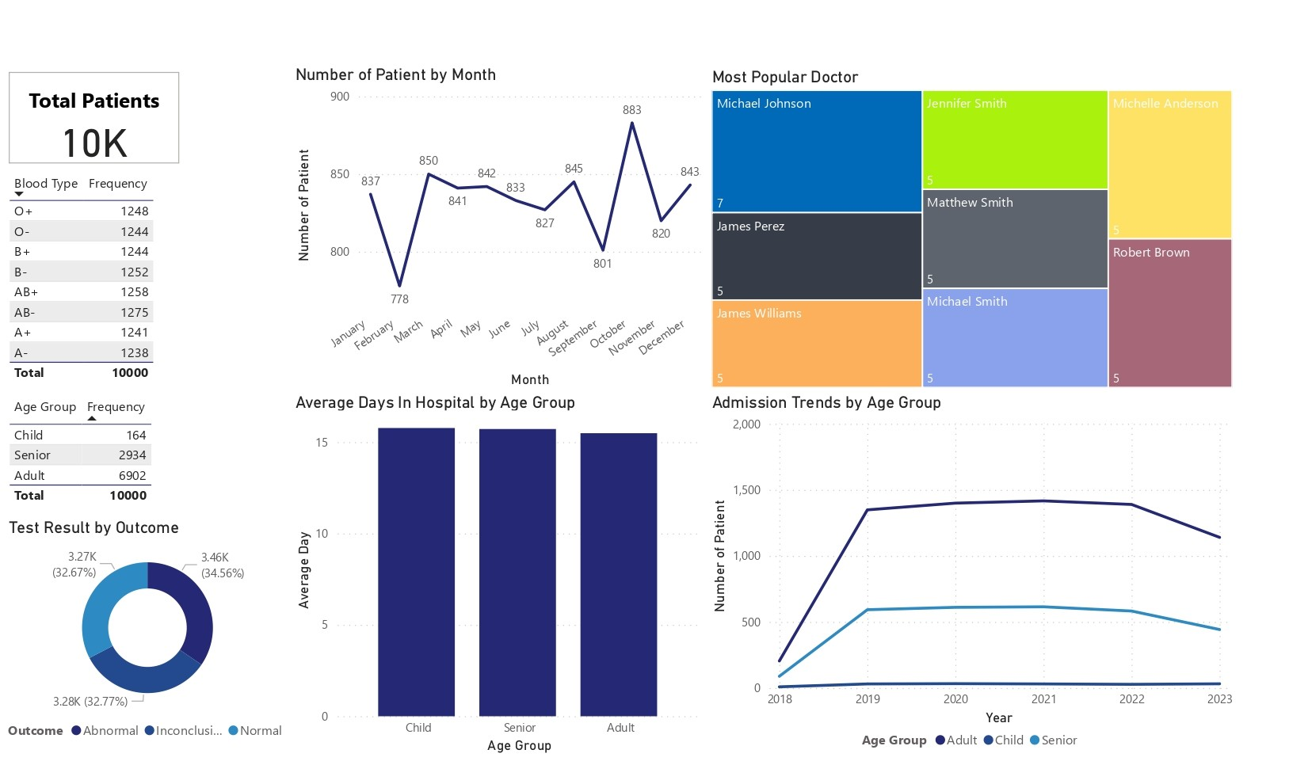
Dashboard

Slide 12
Dashboard Description
The dataset contains a total of 10,000 patients, with AB- being the most common blood type. However, all blood types are present in almost similar numbers. It consists of 64 children, 2,934 seniors, and 6,902 adults.
The line graph illustrates that the highest number of hospital admissions occurs in November, reaching 883, while February sees the lowest admissions at 778.
The most frequented doctor is Michael Johnson, as indicated in the dashboard’s Treemap. On average, children spend more days in the hospital compared to other age groups.
Although the number of child admissions remains steady over the years, adult and senior admissions sharply rise after 2018, stabilizing until 2022 before declining in 2023.
Normal test outcomes are observed in 32.57% of cases.

Slide 13
Conclusion
We conclude that hospitals need to prepare for November, as it consistently sees the highest number of admissions. Allocating more resources during this month would ensure adequate support for the influx of patients. Given the lower proportion of children in the dataset, hospital administrations should consider hiring additional medical professionals targeting adult and senior care. Efforts should also be made to reduce inconclusive test outcomes by implementing proper methods and tools.

Slide 14
References
Prasad22. (2023). Healthcare Dataset [Data file]. Retrieved from Kaggle: https://www.kaggle.com/datasets/prasad22/healthcare-dataset
Bradley, E. H., Curry, L. A., & Devers, K. J. (2007). Qualitative Data Analysis for Health Services Research: Developing Taxonomy, Themes, and Theory. Health Services Research, 42(4), 1758–1772.
https://onlinelibrary.wiley.com/doi/10.1111/j.1475-6773.2006.00684.x
Po, L., Bikakis, N., Desimoni, F., & Papastefanatos, G. (2020). Linked Data Visualization: Techniques, Tools and Big Data. Morgan & Claypool. Retrieved from http://www.linkeddatavisualization.com
Templ, M., Alfons, A., & Filzmoser, P. (2011). Exploring Incomplete Data Using Visualization Techniques. Journal Name, Volume(Issue), Page range. https://citeseerx.ist.psu.edu/document?repid=rep1&type=pdf&doi=deb726115c73cbc68192bb9083bd3a1be9b2c9aa

Slide 15
THANK YOU

